Slide 1

Department of Computer Science Engineering
(AIML)
A.P. Shah Institute of Technology G.B.Road,Kasarvadavli, Thane(W), Mumbai-400615 UNIVERSITY OF MUMBAI Academic Year 2022-2023

Slide 2
Synopsis On:
Event Management Website
Submitted in partial fulfillment of the degree of Bachelor of Engineering(Sem-3) in Computer Science Engineering
(AIML)
Presented By:
Kartik Parmar - 22106101
Jay Patil- 22106020
Pratham Patange- 22106045
Niraj Patel-22106050
Project Guide
Prof. Shraddha Dalvi

Slide 3
index
Introduction
Objectives
Problem Statement
Block diagram
Tools/Softwares,Languages used
Implementation
Conclusion
References

Slide 4
INtroduction
An event management website serves as a critical platform for individuals and organizations looking to plan, promote, and execute successful events. Here are three to four key points that introduce the significance and purpose of such a website:
Centralized Event Planning
Efficient Promotion and Marketing
Login and Registration
Streamlined Communication

Slide 5
OBJECTIVES
We intend to fulfil the following objectives with this project:
To design a intuitive and appealing user interface.
To have an effective event Planning and execution.
To ensure a smooth execution of the event.
To have a proper database of the consumer.

Slide 6
PROBLEM STATEMENT
Considering the existing system problems related to event management we are developing an Website for event management.
This will mainly focus on booking of birthday party, marriage functions and social events.
Website will have easy and feasible GUI for all type of users. User needs to Login at the initial phase, set his/her profile details including name, choices, email-id, etc.

Slide 7
BLOCK DIAGRAM

Slide 8
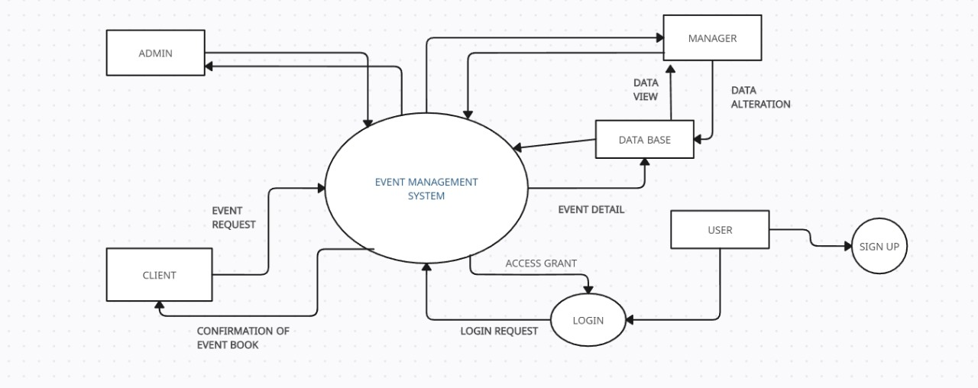

Slide 9
Tools/Softwares,Languages used
HTML(HYPER TEXT MARKUP LANGUAGE ) VERSION 5
CSS(CASCADING STYLE SHEETS)VERSION 3
VIRTUAL STUDIO CODING SOFTWARE
PHP(HYPERTEXT PREPROCESSOR)USING PHPMYADMIN server
JAVA SCRIPT
DBMS(DATA BASE MANAGEMENT SYSTEM) USING XAMMP

Slide 10







Slide 11
PROJECT WORK

Slide 12
Implementation

Slide 13
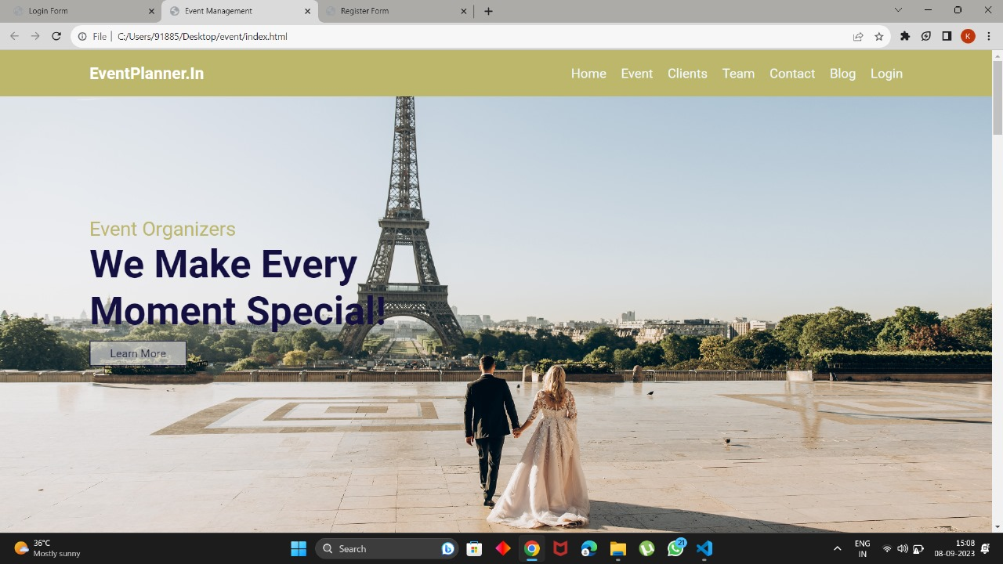
HOME PAGE

Slide 14
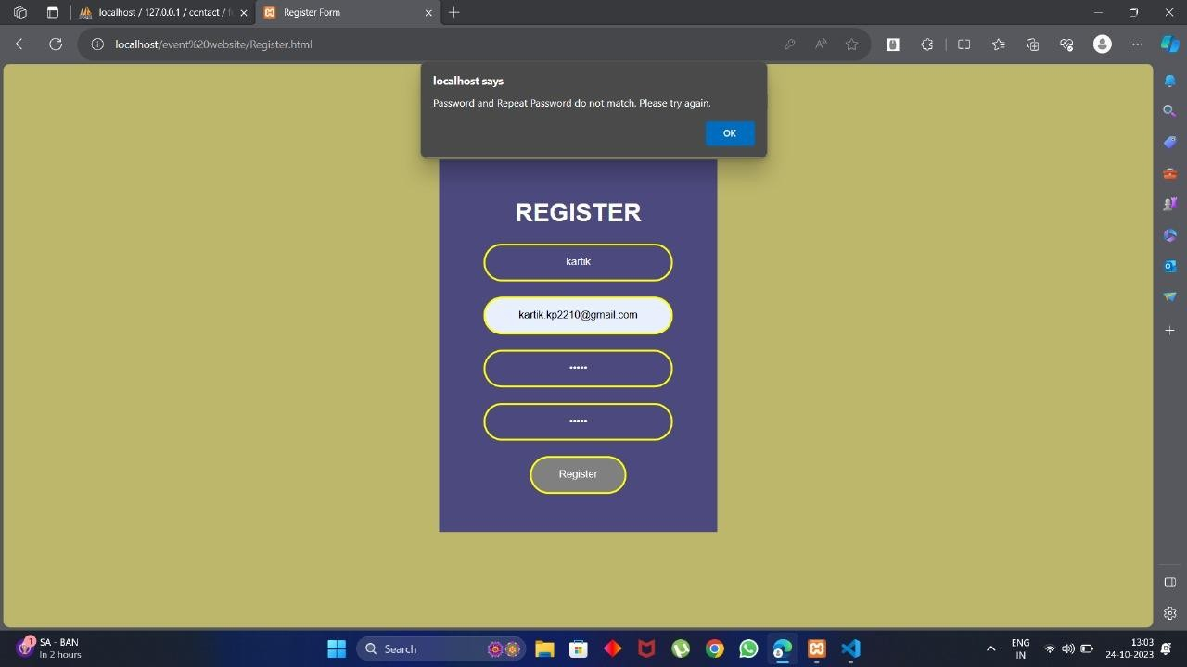
REGISTER PAGE

Slide 15
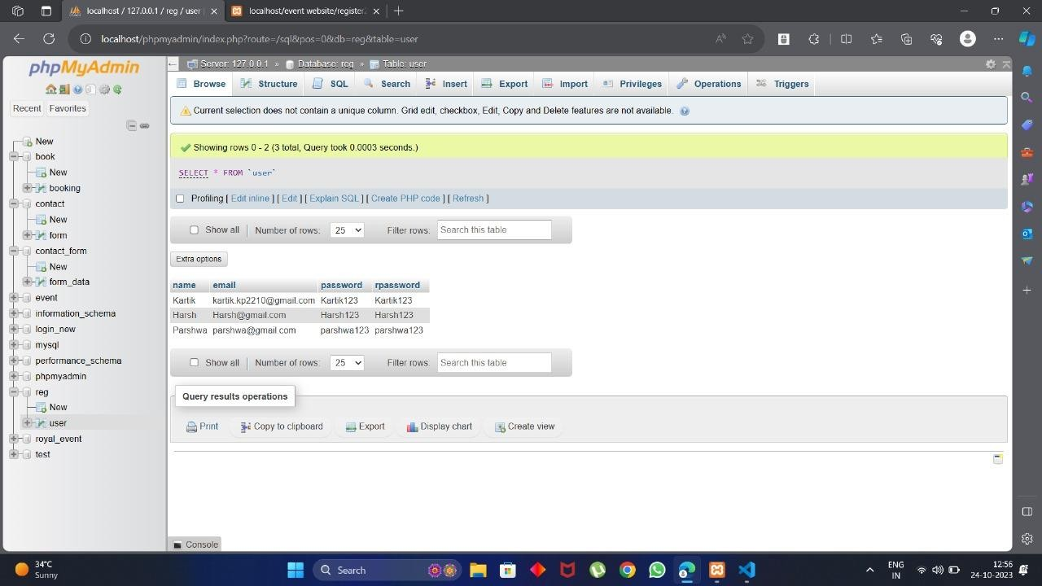
REGISTRATION IN BACKEND

Slide 16
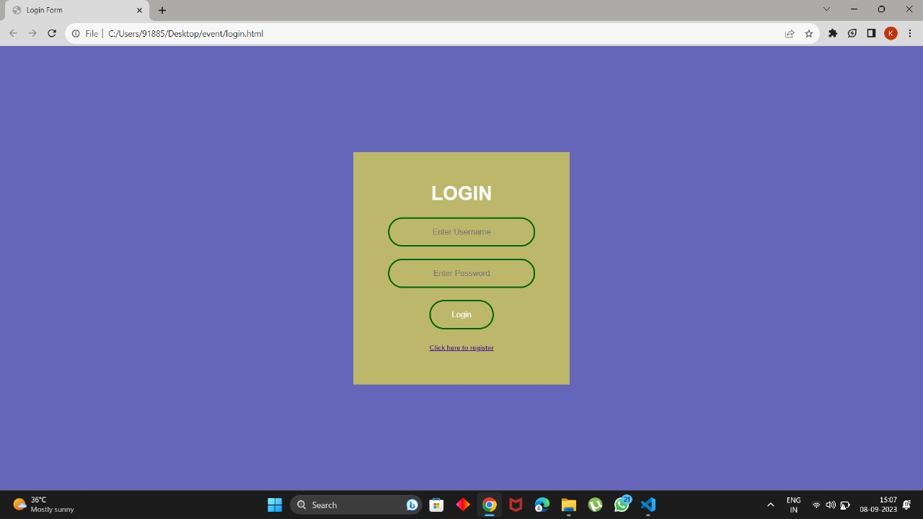
LOGIN PAGE

Slide 17
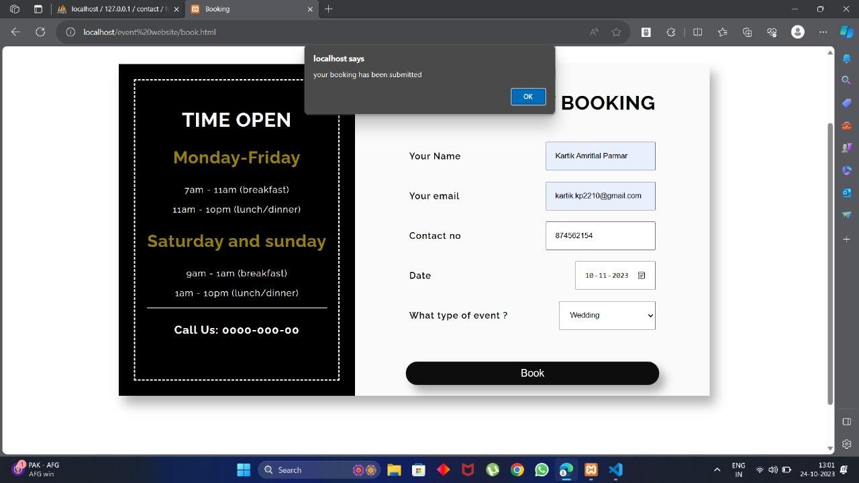
BOOKING OF THE EVENT

Slide 18
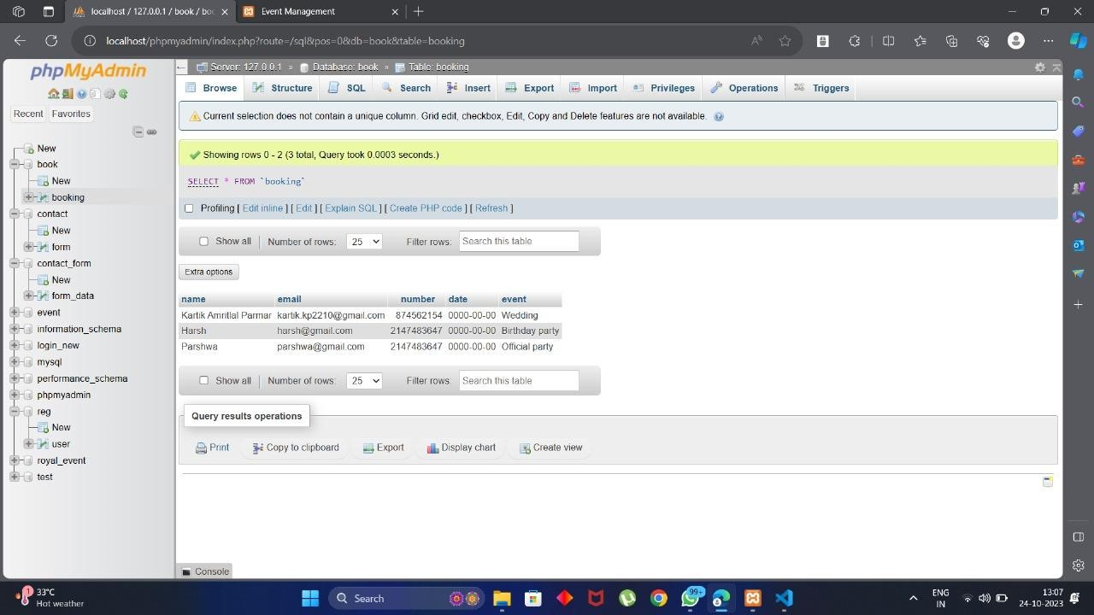
BOOKING IN BACKEND

Slide 19
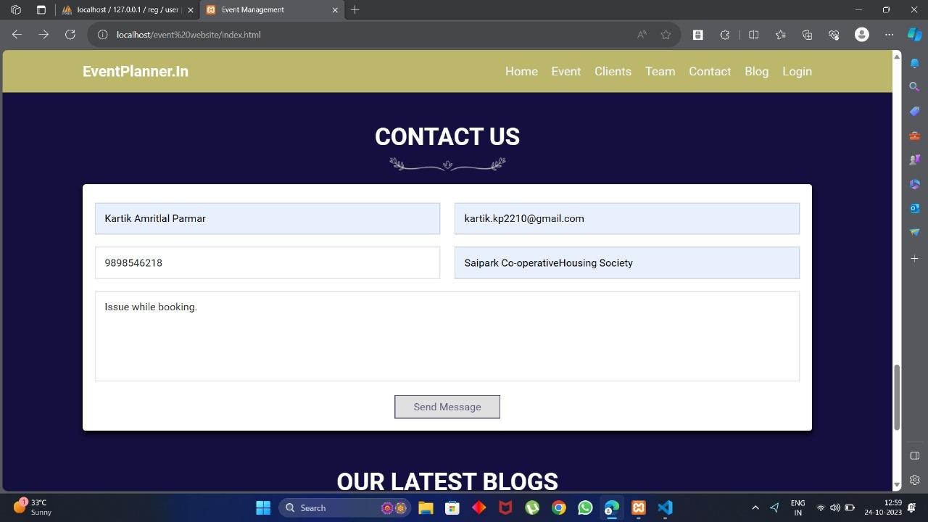
CONTACT US

Slide 20
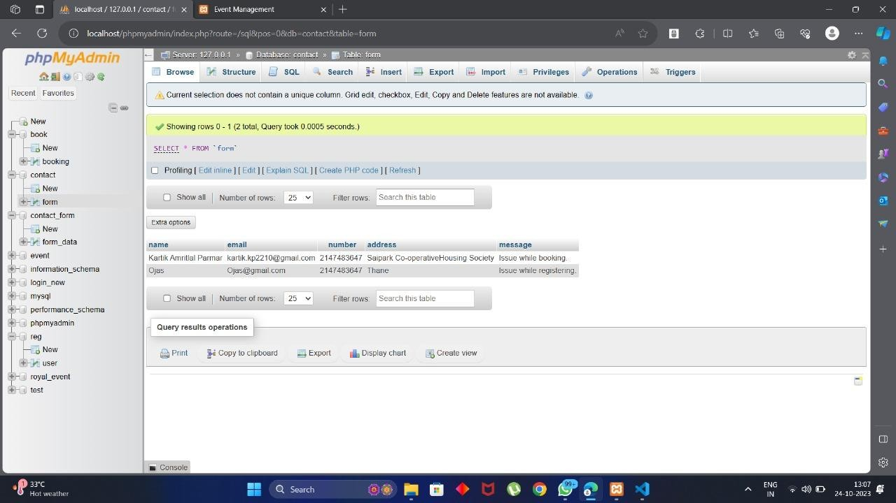
CONTACT US IN BACKEND

Slide 21
CONCLUSION
We conclude that creating an event management website using HTML and CSS offers a cost-effective and highly customizable solution for small to medium-sized businesses.
We conclude our project with the frontend and backend of the website using Data Base Management System(DBMS),PHP, Java script , HTML and CSS.

Slide 22
references
JOURNAL PAGES:-
Tang, Xiaoyu. "A website for event management system." (2016).
Mounika, Podila, Sunkesula Divya Sree, Tatikonda Sushmitha, And Gujja Harsha Sree. "College Event Management System Using Web Technologies.“
Van Der Wagen, Lynn. Event Management. Pearson Higher Education AU, 2010.
Kaur, Bhavneet. "PROJECT SEMESTER REPORT EVENT MANAGEMENT." (2020).

Slide 23
Srikant Patnaik, Khushboo Kumari Singh, Rashmi Ranjan,“COLLEGE MANAGEMENT SYSTEM”, issued by:IRJET, vol:3, issue:5, may-2016.
Amir Saleem, Davood Ahmed Bhat, Mr.Omar Farooq Khan,”Review paper on an Event Management System”, IJCSMC, Vol.6, Issue. 7, July 2017.
Sanjatul Islam, 2Rajashree Majumder, 3Subrina Sultana,”TOWARD A GENERIC EVENT MANAGEMENT SYSTEM FOR ACADEMIA”,28 September 2019.

Slide 24
Thank You

